Slide 1
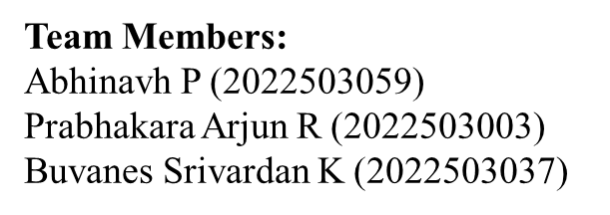
Federated Learning for Code Generation with Hallucination-Aware Fine Tuning EXTERNAL VIVA
CS6811 – Project Work
MENTOR
Dr. B. Thanasekhar,
Professor,
Computer Technology, MIT

Slide 2
INTRODUCTION
Large Language Models (LLMs) have remarkable capabilities in code generation ,enabling automated solutions to a wide range of software engineering tasks.
However LLMs frequently suffer from hallucinations in code generation, producing syntactically valid but semantically incorrect programs, non-existent APIs, or logically flawed implementations.
Existing approaches to mitigating code hallucinations primarily rely on prompt engineering, repeated sampling, or full model fine-tuning.
Full fine-tuning is computationally expensive and impractical in low-resource or decentralized settings, and repeated sampling does not address the underlying causes and mitigation of hallucination.
In real-world development environments, code generation systems are often deployed across multiple decentralized clients where data cannot be centrally aggregated due to privacy, ownership.
To address these limitations we propose a hallucination-aware code generation framework that combines program analysis, and federated parameter-efficient fine-tuning using LoRA.

Slide 3
PROBLEM STATEMENT
Code generation using large language models (LLMs) is currently hindered by hallucinations. Existing mitigation strategies typically rely on supervised fine-tuning or reinforcement learning from human feedback (RLHF), where models are trained to align with human preferences .While parameter-efficient fine-tuning methods such as LoRA reduce computational overhead compared to full fine-tuning, both approaches primarily optimize model behavior but without explicit verification of program correctness. As a result, these methods may improve correctness but often fail to systematically detect and correct deeper structural, semantic, and execution-level errors in generated code.
Furthermore, in real world scenarios, high-quality code and execution feedback are distributed across multiple organizations making centralized data collection infeasible due to privacy concerns. Without a secure and decentralized learning mechanism, models are unable to effectively learn from diverse hallucination patterns observed across clients. This creates a critical gap for a unified framework that integrates explicit hallucination detection and automated program verification with privacy-preserving, parameter-efficient adaptation to improve the quality of code generation .

Slide 4
OBJECTIVES
To. Develop a federated learning framework for LLM-based code generation using LoRA, enabling decentralized training across clients while preserving privacy and reducing computational overhead.
Design a hallucination-aware pipeline that detects and classifies code errors using static analysis (AST, LIB/API) and dynamic execution, forming a structured fault taxonomy.
Propose Fed-Error Average, an error-aware aggregation strategy that weights client updates based on hallucination error distributions to handle heterogeneous, non-IID data.
Evaluate the framework on HumanEval, MBPP, and DS-1000 using Pass@1 and CodeBLEU metrics to validate improvements in functional correctness and hallucination reduction.

Slide 5
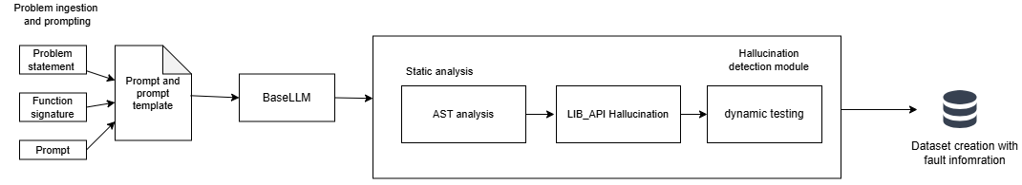
ARCHITECTURE DIAGRAM
Fig1. Client side hallucination detection and mitigation framework

Slide 6
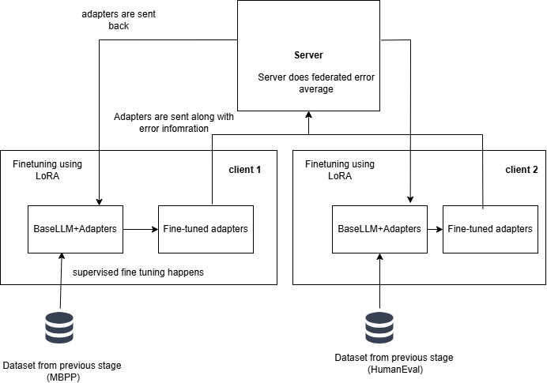
ARCHITECTURE DIAGRAM
Fig 2. Federated learning + LoRA for fine-tuning

Slide 7
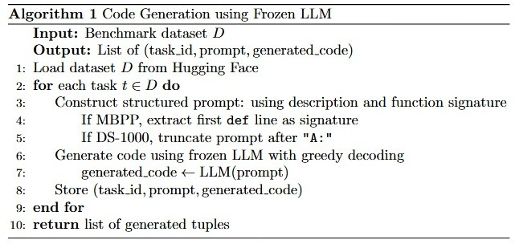
METHODS/MODULES USED
1.Problem ingestion and code generation

Slide 8
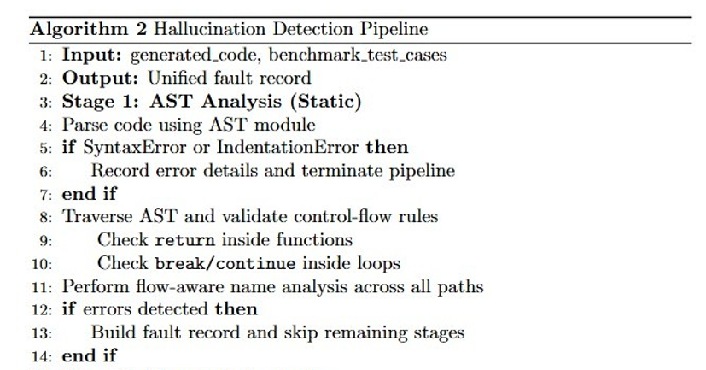
2.Hallucination detection

Slide 9
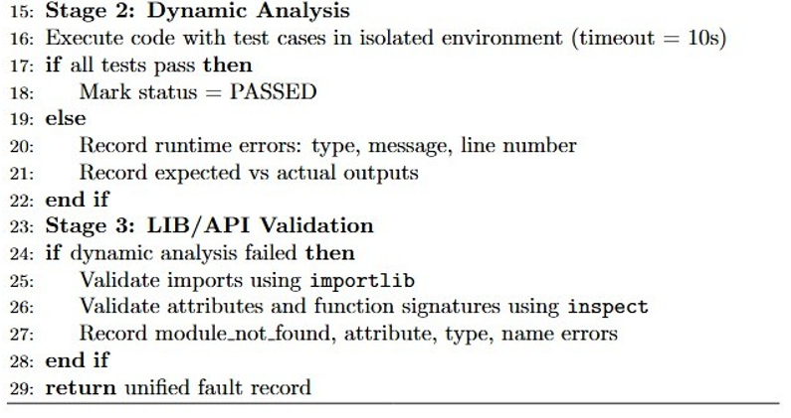
2.Hallucination detection

Slide 10
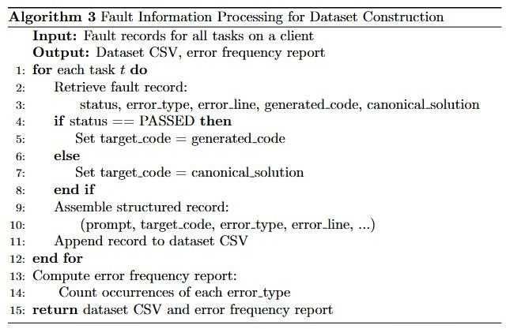
3.Dataset creation

Slide 11
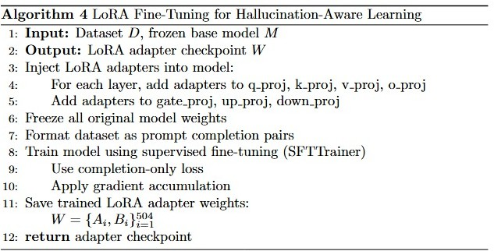
4.Fine tuning using LoRA

Slide 12
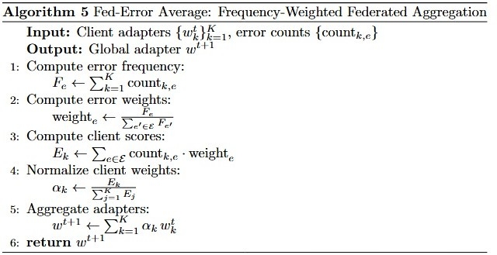
5.Federated Aggregation and Distribution

Slide 13
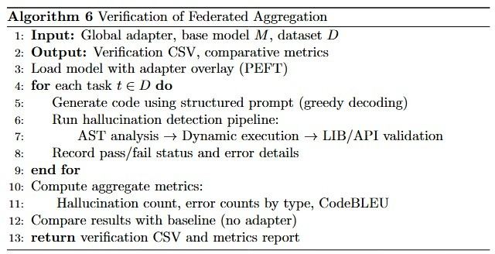
6.Evaluation and analysis

Slide 14
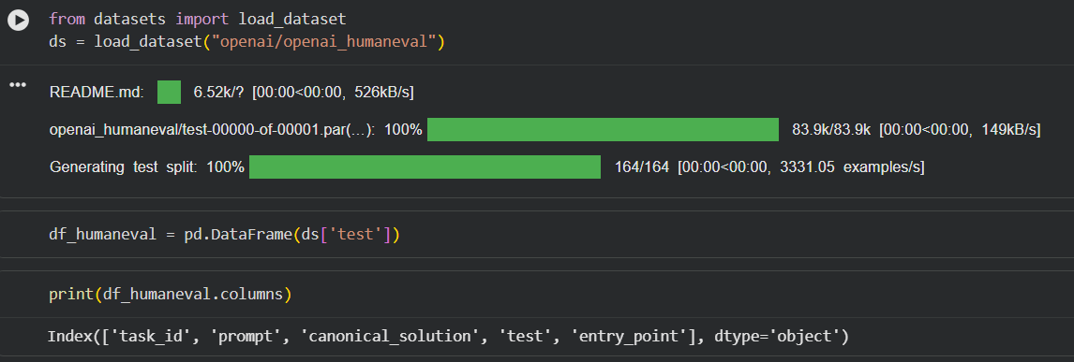
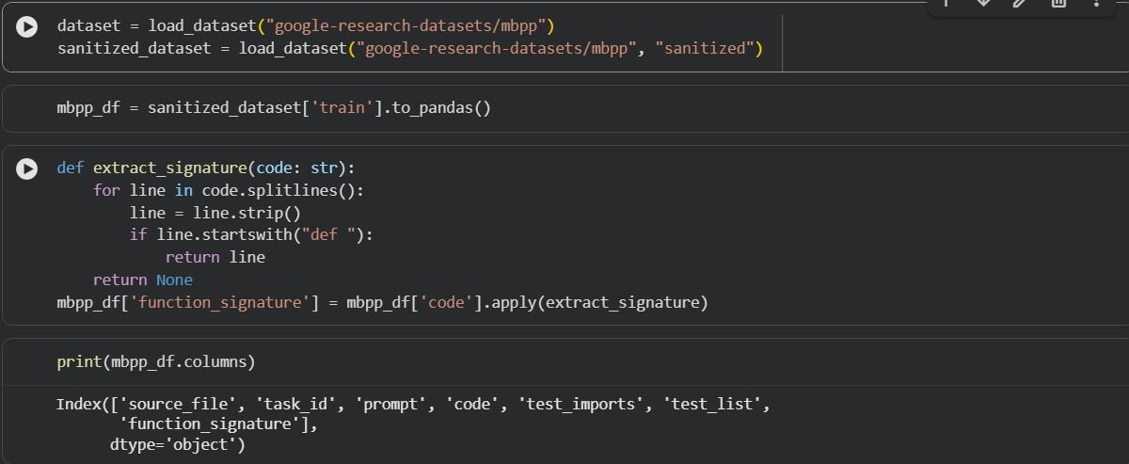
IMPLEMENTATION DETAILS
1.Problem ingestion and code generation
Loading HumanEval dataset
Loading MBPP dataset
Extraction function signature in MBPP
which will be later used for testing.

Slide 15
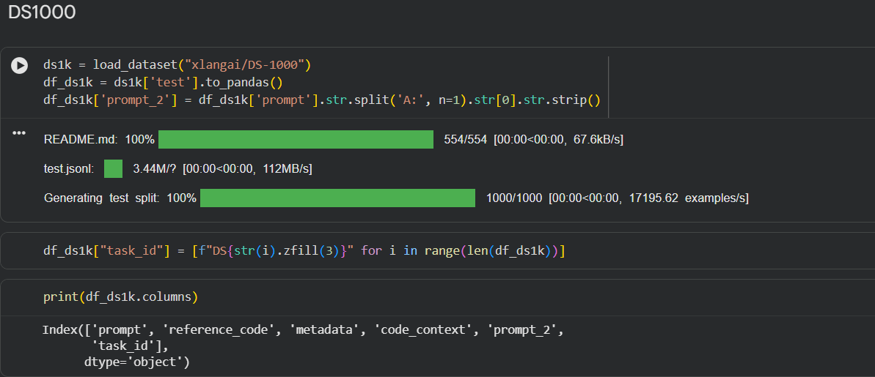
IMPLEMENTATION DETAILS
1.Problem ingestion
Loading DS1000 dataset
Created a column task_id to track data

Slide 16
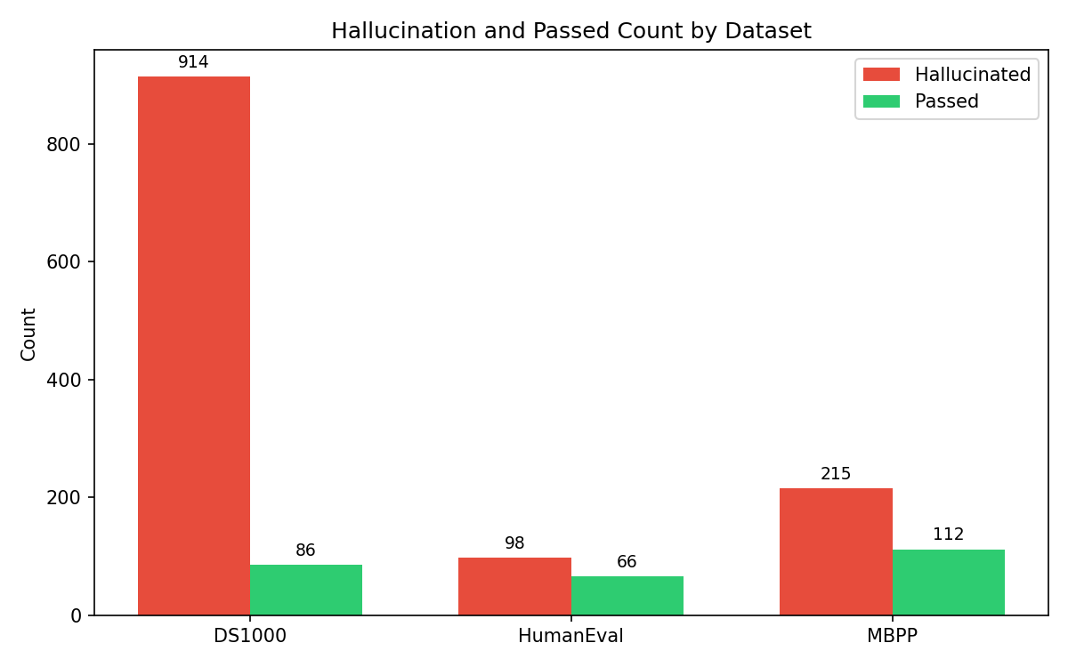
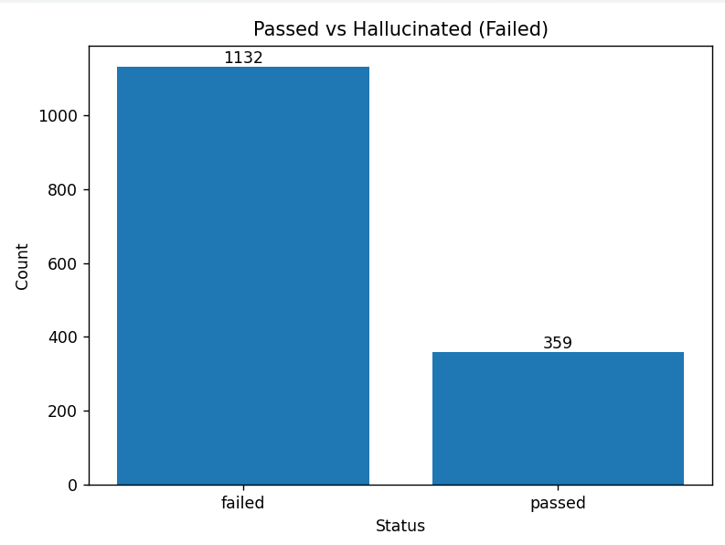
IMPLEMENTATION DETAILS
2.Hallucination detection
Hallucinated Vs Pass count across dataset
Overall pass and hallucinated code

Slide 17
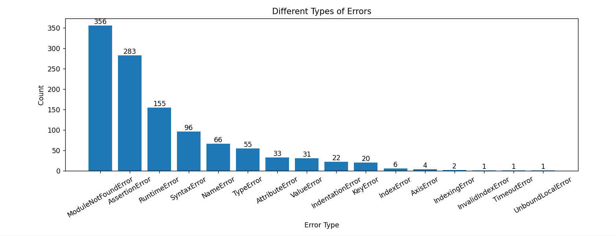
IMPLEMENTATION DETAILS
2.Dynamic Analaysis
Types of hallucination at runtime

Slide 18
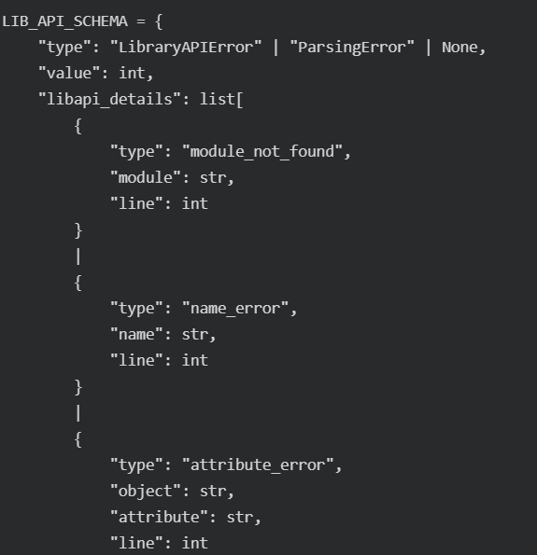
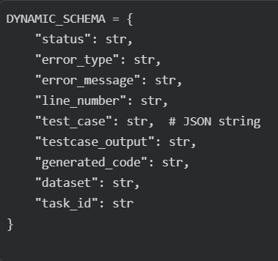
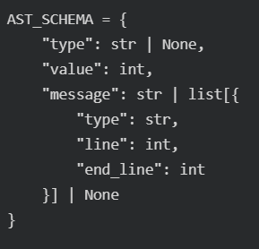
IMPLEMENTATION DETAILS
3.Dataset creation
Fault information across different modules are collected for dataset creation and fine-tuning

Slide 19
IMPLEMENTATION DETAILS
4.LoRA Fine Tuning
Parameter | Value
r (rank) | 16
lora_alpha | 32
target_modules | 7 projections (q_proj, v_proj, k_proj, o_proj, gate_proj, up_proj, down_proj)
lora_dropout | 0.05
bias | "none"
task_type | CAUSAL_LM
LoRA Configuration for PEFT

Slide 20
IMPLEMENTATION DETAILS
4.LoRA Fine Tuning
Parameter | Value
num_train_epochs | 3
per_device_train_batch_size | 2
gradient_accumulation_steps | 4
learning_rate | 2e-4
weight_decay | 0.01
warmup_ratio | 0.03
lr_scheduler_type | cosine
max_grad_norm | 0.3
max_seq_length | 2048
packing | False
bf16 / fp16 | auto-detect
save_strategy | epoch
save_total_limit | 1
logging_steps | 5
Configuration for SFT

Slide 21
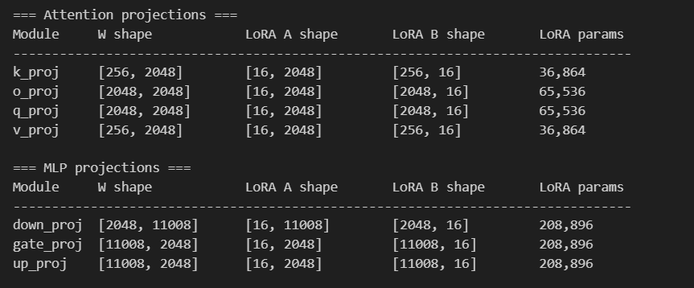
IMPLEMENTATION DETAILS
4.LoRA Fine Tuning
Adapters obtained after SFT
The number of trainable parameters gets reduced from 2.7B to 29.9 M.
Each targeted projection of layer get’s two matrices A and B. Having 36 transformer layers and 7 projection
per layer on decomposition we yield 504 adapters.

Slide 22
IMPLEMENTATION DETAILS
5. Federated aggregation
Figure 6.1.a: Output of fine-tuned adapters after Federated average (complete dataset)
Figure 6.2.a: Output of fine-tuned adapters after Federated average (Training dataset)
Figure 6.1.b: Output of fine-tuned adapters after Federated Error average (complete dataset)
Figure 6.2.b: Output of fine-tuned adapters after Federated Error average (Training dataset)

Slide 23
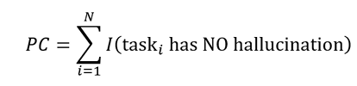
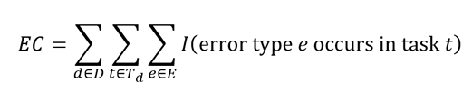
EVALUVATION METRIC
Pass count: Total number of tasks that pass all detection stages (AST + API+Dynamic).
Error count :Total number of hallucination errors (by type) detected across all datasets. Each task can contribute multiple error types, so this counts error instances,not tasks.

Slide 24
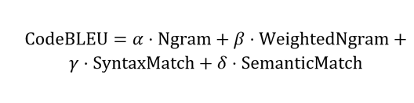
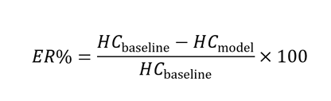
EVALUVATION METRIC
CodeBLEU A similarity metric that measures the lexical and syntactic alignment between generated code and reference solutions, incorporating n-gram matching, syntax structure similarity and data flow similarity.
Error reduction: It measures the percentage decrease in hallucination errors achieved by the model compared to the baseline.

Slide 25
RESULTS AND ANALYSIS
Hallucination and pass count for benchmarking dataset

Slide 26
RESULTS AND ANALYSIS
Error_Type | DS1000 | HumanEval | MBPP | Total
AssertionError | 188 | 20 | 75 | 283
AttributeError | 31 | 1 | 1 | 33
AxisError | 4 | 0 | 0 | 4
IndentationError | 90 | 0 | 0 | 90
IndexError | 4 | 1 | 1 | 6
IndexingError | 2 | 0 | 0 | 2
InvalidIndexError | 1 | 0 | 0 | 1
KeyError | 20 | 0 | 0 | 20
ModuleNotFoundError | 352 | 3 | 1 | 356
NameError | 55 | 4 | 7 | 66
RuntimeError | 155 | 0 | 0 | 155
SyntaxError | 4 | 6 | 94 | 104
TimeoutError | 0 | 1 | 0 | 1
TypeError | 46 | 1 | 8 | 55
UnboundLocalError | 0 | 0 | 1 | 1
ValueError | 28 | 0 | 3 | 31
attribute_error | 22 | 0 | 0 | 22
missing_return | 3 | 53 | 66 | 122
module_not_found | 43 | 0 | 0 | 43
name_error | 1 | 52 | 0 | 53
type_error | 343 | 0 | 0 | 343
Total | 1392 | 142 | 257 | 1791
Types of errors with frozen model across all three dataset.

Slide 27
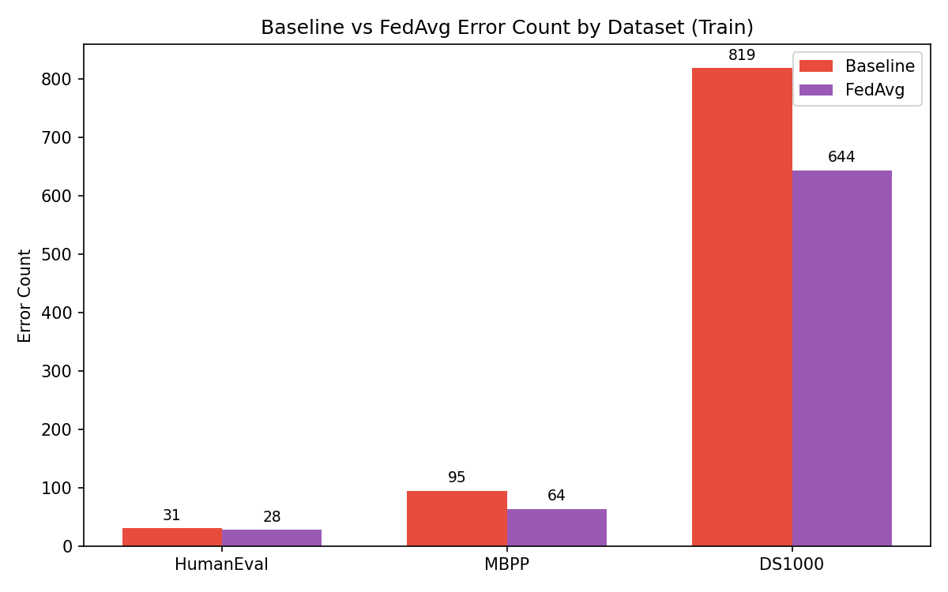
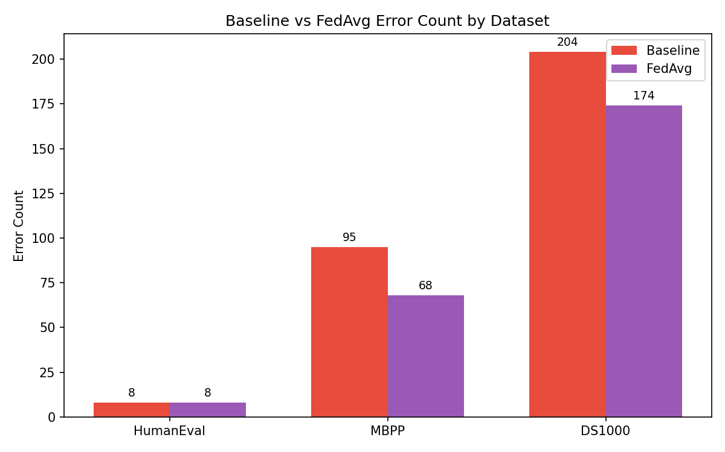
RESULTS AND ANALYSIS
Hallucination count across all datasets after federated average,
for the complete dataset
Hallucination count across all datasets after federated average,
for the testing part of the dataset

Slide 28
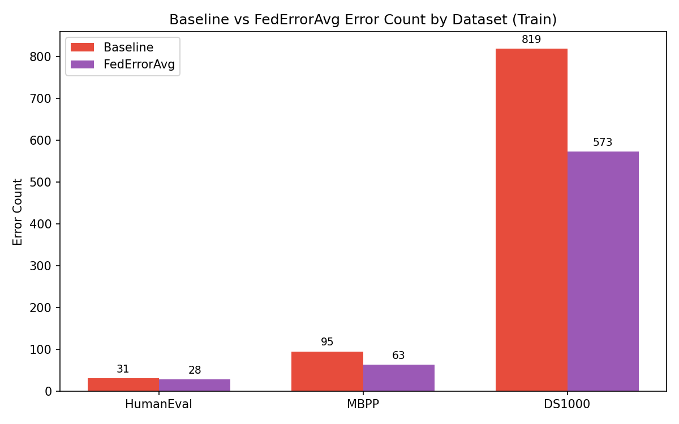
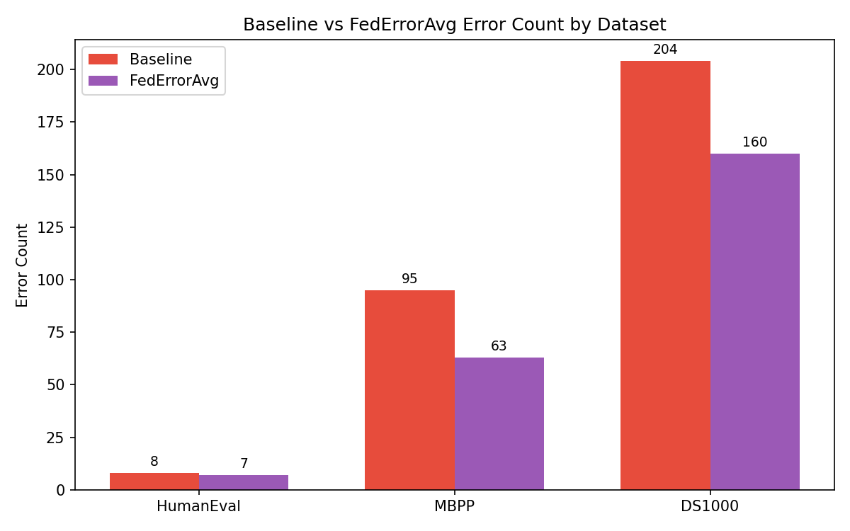
RESULTS AND ANALYSIS
Hallucination count across all datasets after Fed-Error average,
for the complete dataset
Hallucination count across all datasets after Fed-Error average,
for the testing part of the dataset

Slide 29
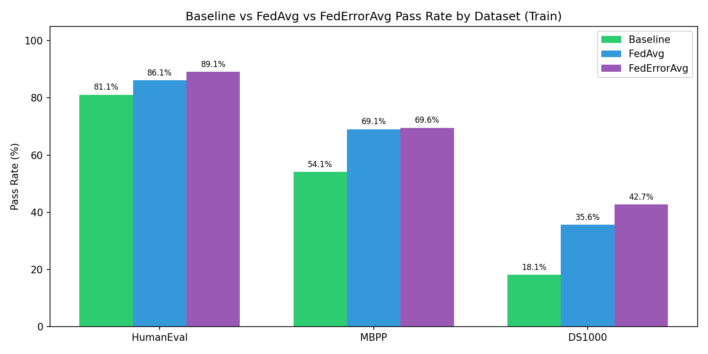
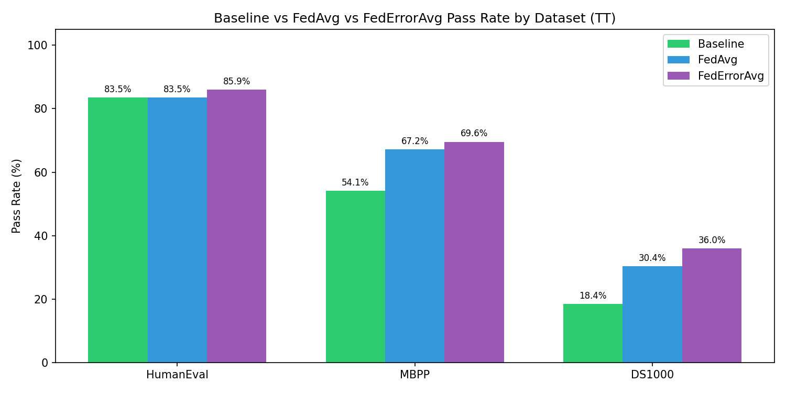
RESULTS AND ANALYSIS
Pass rate across all datasets after Fed-Error average,
for the complete dataset
Pass rate across all datasets after Fed-Error average,
for the testing part of the dataset

Slide 30
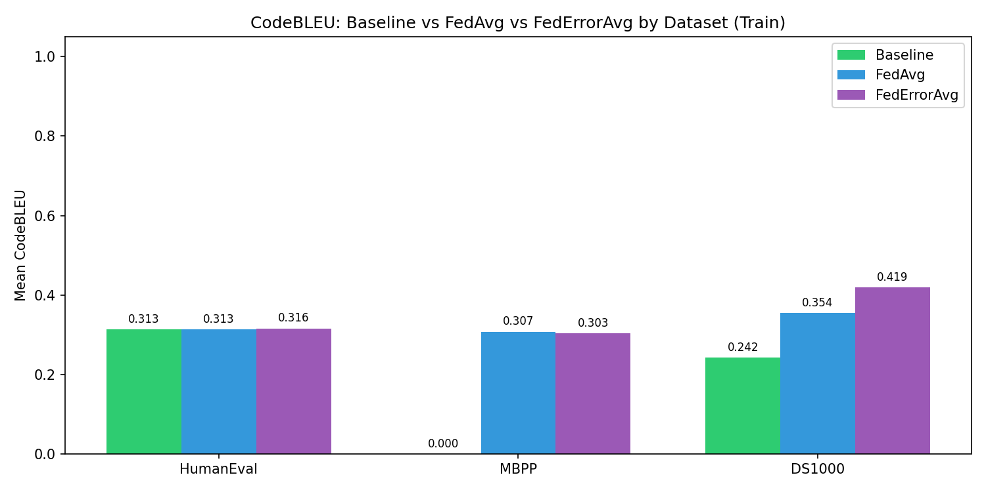
RESULTS AND ANALYSIS
CodeBLEU:is a metric for evaluating the quality of AI-generated code against reference code.
It's an extension of the classic BLEU score but specifically designed for code.
CodeBLEU comparison between baseline,FedAverage and FedErrorAverage

Slide 31
RESULTS AND ANALYSIS
error_type | baseline_ count | fedavg_ count | federroravg_ count | reduction
AssertionError | 126 | 135 | 126 | 0
AttributeError | 14 | 5 | 7 | 7
AxisError | 1 | 2 | 1 | 0
FileNotFoundError | 1 | 0 | 0 | 1
IndentationError | 18 | 16 | 16 | 2
IndexError | 2 | 4 | 5 | 0
InternalError | 0 | 5 | 5 | 0
InvalidIndexError | 1 | 0 | 0 | 1
KeyError | 5 | 16 | 6 | 0
NameError | 71 | 17 | 13 | 58
NotFittedError | 2 | 2 | 0 | 2
RuntimeError | 3 | 2 | 3 | 0
SyntaxError | 19 | 9 | 10 | 9
TimeoutError | 3 | 0 | 0 | 3
TypeError | 24 | 17 | 18 | 6
UnboundLocalError | 1 | 0 | 0 | 1
ValueError | 16 | 20 | 20 | 0
Error reduction comparison for Fed- Error average and baseline for test dataset

Slide 32
error_type | baseline_count | fedavg_count | federroravg_count | reduction
AssertionError | 379 | 364 | 365 | 14
AttributeError | 58 | 43 | 40 | 18
AxisError | 4 | 1 | 0 | 4
FileNotFoundError | 3 | 0 | 0 | 3
IndentationError | 69 | 48 | 60 | 9
IndexError | 6 | 9 | 9 | 0
IndexingError | 2 | 0 | 0 | 2
InvalidIndexError | 1 | 0 | 0 | 1
KeyError | 19 | 54 | 18 | 1
LinAlgError | 1 | 0 | 0 | 1
ModuleNotFoundError | 2 | 1 | 2 | 0
NameError | 201 | 56 | 40 | 161
NotFittedError | 6 | 5 | 2 | 4
NotImplementedError | 2 | 1 | 1 | 1
OverflowError | 0 | 1 | 0 | 0
QhullError | 0 | 1 | 1 | 0
RecursionError | 0 | 1 | 0 | 0
RuntimeError | 11 | 7 | 7 | 4
SyntaxError | 24 | 4 | 4 | 20
TimeoutError | 14 | 0 | 0 | 14
TypeError | 80 | 85 | 84 | 0
UFuncTypeError | 0 | 4 | 4 | 0
UnboundLocalError | 1 | 0 | 0 | 1
UnidentifiedImageError | 1 | 0 | 0 | 1
ValueError | 61 | 62 | 55 | 6
return_outside_function | 0 | 16 | 6 | 0
Error reduction comparison for Fed- Error average and baseline

Slide 33
EXPERIMENTAL SETUP
Base LLM :
QwenCoder2.5-3B parameter is used as base model.
Type: Causal Language Models
Training Stage: Pretraining & Post-training
Number of Parameters: 3.09B
Number of Paramaters (Non-Embedding): 2.77B
Number of Layers: 36
Number of Attention Heads (GQA): 16 for Q and 2 for KV
Context Length: Full 32,768 tokens
Deterministic Generation Settings: We configured do_sample = False and temperature = 1.0 to ensure deterministic and reproducible code generation across multiple runs.

Slide 34
EXPERIMENTAL SETUP
Dataset:
Dataset | Source | Task Count | Domain | Used For
HumanEval | Hugging Face (openai/evals) | 164 | Functional correctness | Code generation, hallucination detection, SFT
MBPP | Hugging Face (google- research- datasets/mbpp, sanitized) | 377 | Basic algorithms | Code generation, hallucination detection, SFT
DS-1000 | Hugging Face (xlangai/DS- 1000) | 1000 | Data science (NumPy, Pandas, etc.) | Code generation, hallucination detection, SFT

Slide 35
EXPERIMENTAL SETUP
Runtime Environment:
Google Colab: Used for LLM inference, code generation, and initial pipeline development; utilized NVIDIA T4 GPU with CUDA support.
VS Code: Used for local development of static and dynamic analysis modules, dataset processing, and result analysis; integrated with Git/GitHub for version control.
JupyterHub (CTSKII): Used for fine-tuning and federated learning experiments; provided NVIDIA A4000 GPU with persistent storage and containerized environment.

Slide 36
REFERENCE
[1] S. Fakhoury, A. Naik, G. Sakkas, S. Chakraborty and S. K. Lahiri, "LLM Based Test-Driven Interactive Code Generation: User Study and Empirical Evaluation," IEEE Transactions on Software Engineering, vol. 50, no. 9, pp. 2254–2268, Sept. 2024, doi: 10.1109/TSE.2024.3428972.
[2] R. Khojah, F. G. de Oliveira Neto, M. Mohamad and P. Leitner, "The Impact of Prompt Programming on Function-Level Code Generation," IEEE Transactions on Software Engineering, vol. 51, no. 8, pp. 2381–2395, Aug. 2025, doi: 10.1109/TSE.2025.3587794.
[3] J. Chen, Z. Cai, W. Chen, W. Wang, Z. Zheng and P. S. Yu, "A Federated Adaptive Large Language Model Fine-Tuning Framework for Software Development," IEEE Transactions on Services Computing, vol. 19, pp. 32 43, Feb. 2026,doi: 10.1109/TSC.2025.3623626.
[4] Z. Liu, Y. Tang, X. Luo, Y. Zhou and L. F. Zhang, "No Need to Lift a Finger Anymore? Assessing the Quality of Code Generation by ChatGPT," IEEE Transactions on Software Engineering, vol. 50, no. 6, pp. 1548–1584, June 2024, doi: 10.1109/TSE.2024.3392499.
[5] M. Nashaat and J. Miller, "Towards Efficient Fine-Tuning of Language Models With Organizational Data for Automated Software Review," IEEE Transactions on Software Engineering, vol. 50, no. 9, pp. 2240–2253, Sept. 2024, doi: 10.1109/TSE.2024.3428324.

Slide 37
REFERENCE
[6] S. Ouyang, J. M. Zhang, Z. Sun and A. M. Penuela, "Knowledge-Enhanced Program Repair for Data Science Code," in Proc. IEEE/ACM 47th Int. Conf. Software Engineering (ICSE), Ottawa, Canada,, pp. 898–910, 2025, doi: 10.1109/ICSE55347.2025.00246. 68
[7] Q. Wang, C. Li, Y. Liu, Q. Zhu, J. Song and T. Shen, "An Adaptive Framework Embedded With LLM for Knowledge Graph Construction," IEEE Transactions on Multimedia, vol. 27, pp. 2912–2923, 2025, doi: 10.1109/TMM.2025.3557717.
[8] B. Yang, J. Dang, H. Liu and Z. Jin, "Advancing LLM-Generated Code Reliability: A Hybrid Approach for Hallucination Detection," IEEE Transactions on Software Engineering, pp. 1–17, 2025, doi: 10.1109/TSE.2025.3640641.
[9] X. Yi, C. Hu, B. Cai, H. Huang, Y. Chen and K. Wang, "FedALoRA: Adaptive Local LoRA Aggregation for Personalized Federated Learning in LLM," IEEE Internet of Things Journal, vol. 12, no. 24, pp. 51854–51865, Dec. 2025, doi: 10.1109/JIOT.2025.3582427.
[10] X. Yu, L. Liu, X. Hu, J. W. Keung, J. Liu and X. Xia, "Fight Fire With Fire: How Much Can We Trust ChatGPT on Source Code-Related Tasks?," IEEE Transactions on Software Engineering, vol. 50, no. 12, pp. 3435–3453, Dec. 2024, doi: 10.1109/TSE.2024.3492204

Slide 38
REFERENCE
[11] H. Zhang, Q. Yan, W. Min, C. Zhang, L. Kuang and Y. Xia, "EvoAPR: Enhancing Large Language Models for Automatic Program Repair with Genetic Algorithm and Dynamic LoRA," in Proc. IEEE Int. Conf. Web Services (ICWS), Helsinki, Finland, pp. 946–956,2025, doi: 10.1109/ICWS67624.2025.00123.
[12] J. Seo, N. Zhang and C. Rong, "Flexible and Secure Code Deployment in Federated Learning using Large Language Models: Prompt Engineering to Enhance Malicious Code Detection," in Proc. IEEE Int. Conf. Cloud Computing Technology and Science (CloudCom), Naples, Italy, pp. 341 349,2023, doi: 10.1109/CloudCom59040.2023.00062. 68
[13] J. Liu, Y. Liao, H. Xu, Y. Xu, J. Liu and C. Qian, "Adaptive Parameter Efficient Federated Fine-Tuning on Heterogeneous Devices," IEEE Transactions on Mobile Computing, vol. 24, no. 11, pp. 12533–12549, Nov. 2025, doi: 10.1109/TMC.2025.3586644.
[14] Y. Tian, W. Yan, Q. Yang, X. Zhao, Q. Chen, W. Wang, Z. Luo, L. Ma and D. Song, "CodeHalu: Investigating Code Hallucinations in LLMs via Execution- based Verification," in Proc. AAAI Conf. Artificial Intelligence (AAAI), pp. 25300–25308, 2025,doi: 10.1609/aaai.v39i24.34717.
[15] J. Liu, Y. Zhang, D. Wang, Y. Li and W. Dong, "THINK: Tackling API Hallucinations in LLMs via Injecting Knowledge," in Proc. IEEE Int. Conf. Software Analysis, Evolution and Reengineering (SANER), Montreal, QC, Canada, pp. 229–240, 2025,doi: 10.1109/SANER64311.2025.00029.

